Slide 1
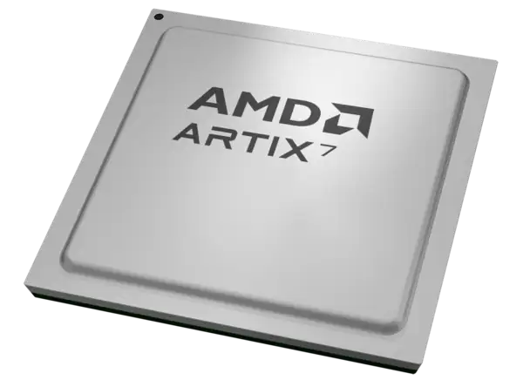
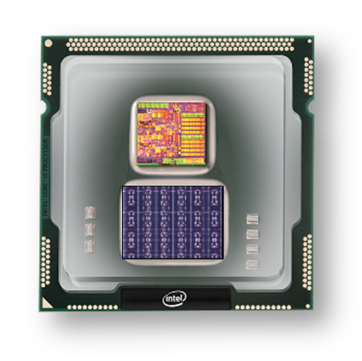
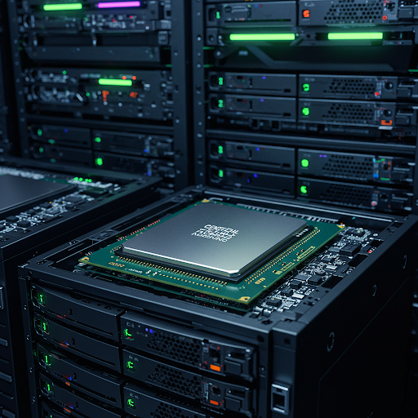
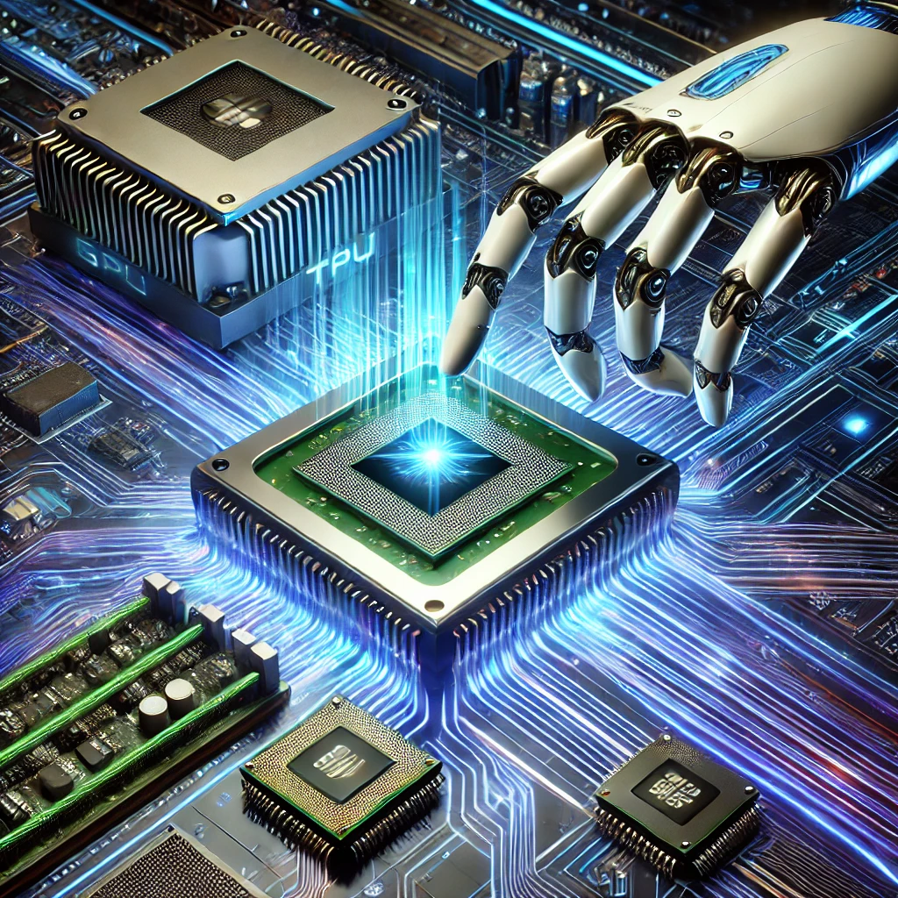
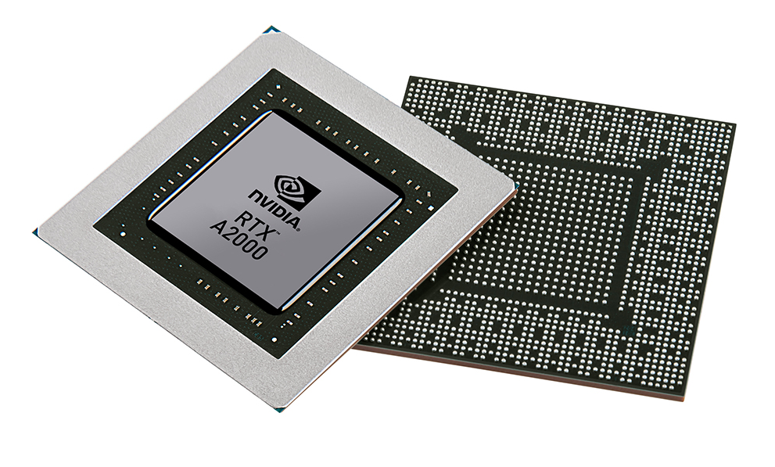


Christof Teuscher
ECE 410/510: Hardware for AI and ML
Week 3: Recap, outlook, and reminders
Portland State University
Department of Electrical and Computer Engineering (ECE)
www.teuscher-lab.com
teuscher@pdx.edu

Slide 2
What did you learn last week?

Slide 3
An analogy for using LLMs
LLMs are your team.
You are becoming more of “manager” who knows how to ask the right questions.
As a manager, it is not necessary that you understand all the technical details of what your team is working on.
You may no be able to help your team directly, but you may be able to ask the right questions to lead them to success.

Slide 4
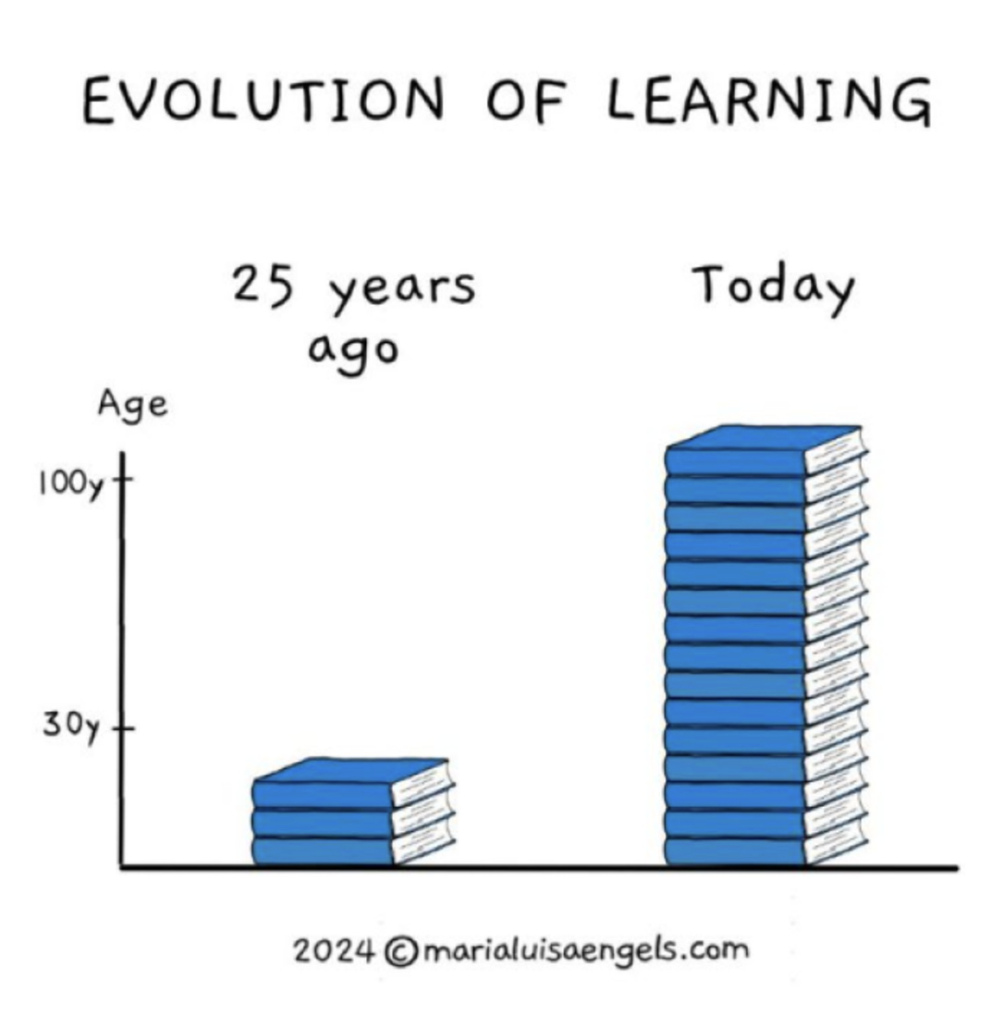
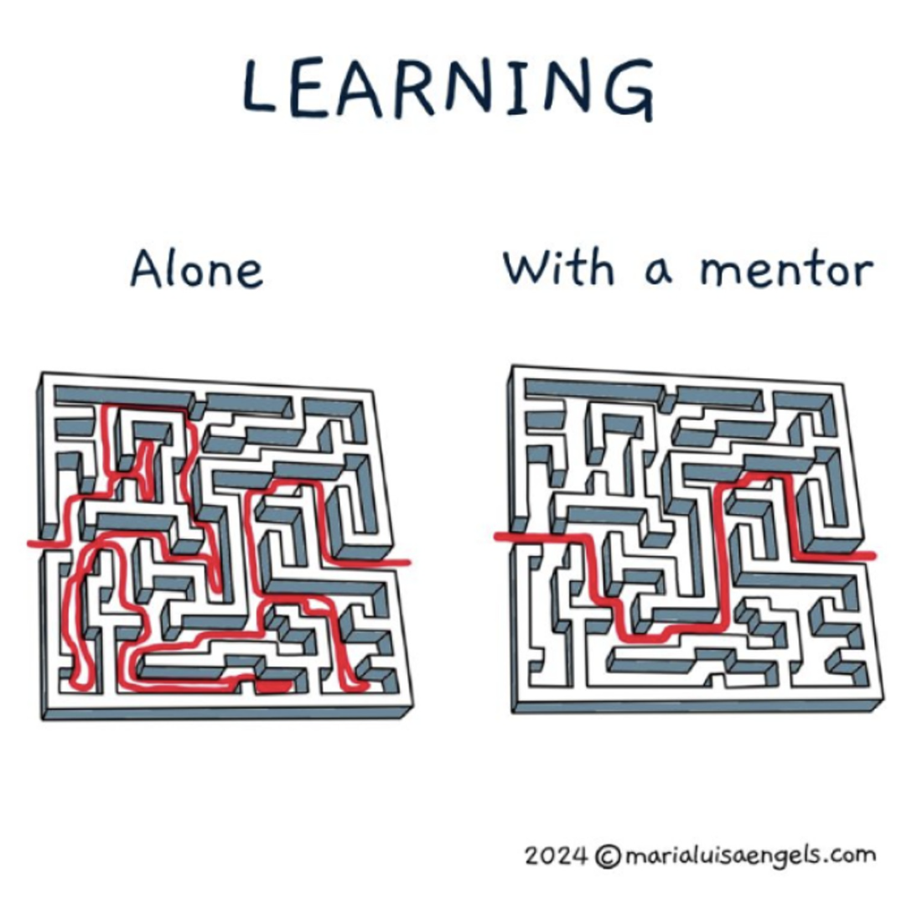
LLMs, please help!
LLM,
Teacher

Slide 5

That might be the wrong question
“Will it work?”
Along the way, we’ve been pushed to load our decisions with a need for certainty. It’s easier, it seems, to not try than it is to fail.
But the question, “is it worth trying?” unlocks possibility.
A surgeon in the middle of an operation should probably not experiment with an untested technique. But a writer, a leader or a musician can make that question part of their craft.
It’s the only way we learn.
https://seths.blog

Slide 6
Week | Monday | Wednesday (Codefest)
2 | HW/AI/ML overview + codesign overview | Start main project: pick workload, start analysis, benchmark, …
3 | GPU architecture and programming for AI | Drafting a HW architecture, creating a model
4 | Deep neural networks on GPUs | Coding HW description
5 | Transformers on GPUs | First simulation + refinement
6 | In-memory computation | Improving initial design
7 | Neuromorphic chips: TrueNorth, Loihi, Akida | Simulation + refinement
8 | Neuromorphic computing with mem-devices | Synthesizing design + benchmarking
9 | Hardware accelerators for embedded systems | Final improvements
10 | Emerging technologies and future directions | Final tests, validation, verification, benchmarking

Slide 7
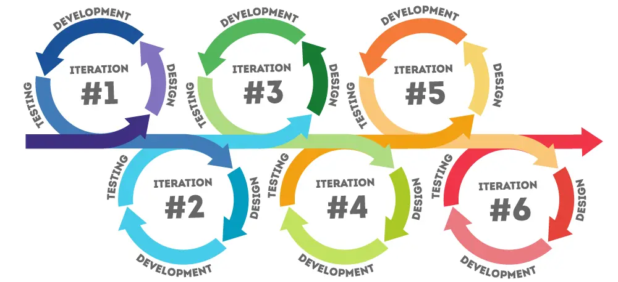
Iterative codesign process
https://www.pacific-research.com/iterative-product-development

